Slide 1

SIGN-LANGUAGE RECOGNITION SYSTEM
Department of Computer Science & Engineering
Swami Keshvanand Institute of Technology, Management & Gramothan, Jaipur
Rajasthan Technical University, Kota
Session 2022-23
SUBMITTED TO: SUBMITTED BY:
Mr. Pratipal Singh Aman Jain (19ESKCS032)
Dept. of Computer Science & Engineering Anshika Mittal (19ESKCS038)
Arunabh Jain (19ESKCS046)
LAB COORDINATOR: Aryan Sharma (19ESKCS047)
Ms. Anjana Sangwan
Dept. of Computer Science & Engineering

Slide 2
INTRODUCTION
The Sign-Language Recognition System is a project aimed at developing a system that can recognize and interpret sign language gestures.
This project addresses the communication barrier between sign language users and non-sign language users, promoting inclusivity and effective communication.
The system utilizes advanced technologies such as computer vision and machine learning to accurately recognize and interpret sign language gestures.

Slide 3
PURPOSE
The purpose of the Sign-Language Recognition System is to bridge the communication gap between sign-language users and non-sign-language users.
The project aims to empower individuals who are deaf or hard of hearing by providing them with a tool to communicate more effectively in various domains.
By developing this system, we strive to enhance inclusivity and accessibility for individuals with hearing impairments.

Slide 4
EXISTING SYSTEM
The current communication system for individuals who use sign language faces limitations and challenges.
There is a significant communication barrier between sign language users and non-sign language users due to the lack of understanding and interpretation of sign language gestures.
This project aims to overcome these challenges by developing a system that can accurately recognize and interpret sign language gestures in real time.

Slide 5
PROPOSED SYSTEM
Dataset Acquisition: The project utilizes a dataset obtained from Kaggle, which consists of images or videos of sign language gestures. This dataset serves as the basis for training the system.
Model Training: A Convolutional Neural Network (CNN) is trained on the captured dataset. The CNN learns to extract meaningful features from sign language gesture images and classify them into different categories.
Model Deployment: The trained model is deployed on a web application using Flask, a Python web framework. Flask enables the integration of the model into a user-friendly web interface.
Prediction: When a user interacts with the web app, they capture an image of a sign language gesture using their device's camera. The captured image is then processed by the deployed model to predict the corresponding sign language gesture.

Slide 6
SCOPE OF PROJECT
The Sign-Language Recognition System has a broad scope with various applications.
It can be integrated into educational settings to assist students who are deaf or hard of hearing, enabling them to actively participate in classroom activities.
In workplaces, the system can facilitate communication between employees with hearing impairments and their colleagues.
Additionally, the system has the potential to be incorporated into everyday communication scenarios, promoting inclusivity in social interactions and public spaces.

Slide 7
TECHNOLOGIES USED
Python, TensorFlow, OpenCV, Keras, Flask, NumPy: These are key technologies used for backend development, machine learning, computer vision, and web framework.
Jupyter Notebook: Used for interactive development, data exploration, and model training.
HTML, CSS, JavaScript: These frontend technologies are employed for structuring, styling, and enhancing the web-based interface.

Slide 8
MAJOR MODULES

Slide 9
#1 MACHINE LEARNING
Data Gathering: This module involves collecting a diverse dataset of sign language gestures, which serves as the training data for the machine learning models.
Data Preprocessing: Before training the models, this module performs data cleaning, normalization, and augmentation to ensure high-quality and well-prepared input data.
Model Building and Training: Using the gathered and preprocessed data, this module constructs and trains machine learning models, such as Convolutional Neural Networks (CNNs), to recognize and classify sign language gestures accurately.
Model Testing: Once the models are trained, this module evaluates their performance using validation datasets to ensure they can recognize a wide range of sign language gestures accurately.

Slide 10
#2 WEB DEVELOPMENT
Frontend Development: This module focuses on creating the user interface of the web application, using HTML, CSS, and JavaScript to design and implement the visual components and interactive elements.
Backend Development: This module deals with building the server-side logic using Python and Flask, handling user requests, processing data, and communicating with machine learning models for gesture recognition.
Integration: This module ensures the smooth integration of the frontend and backend components, connecting the user interface with the machine learning models to enable real-time sign language gesture recognition and display.

Slide 11
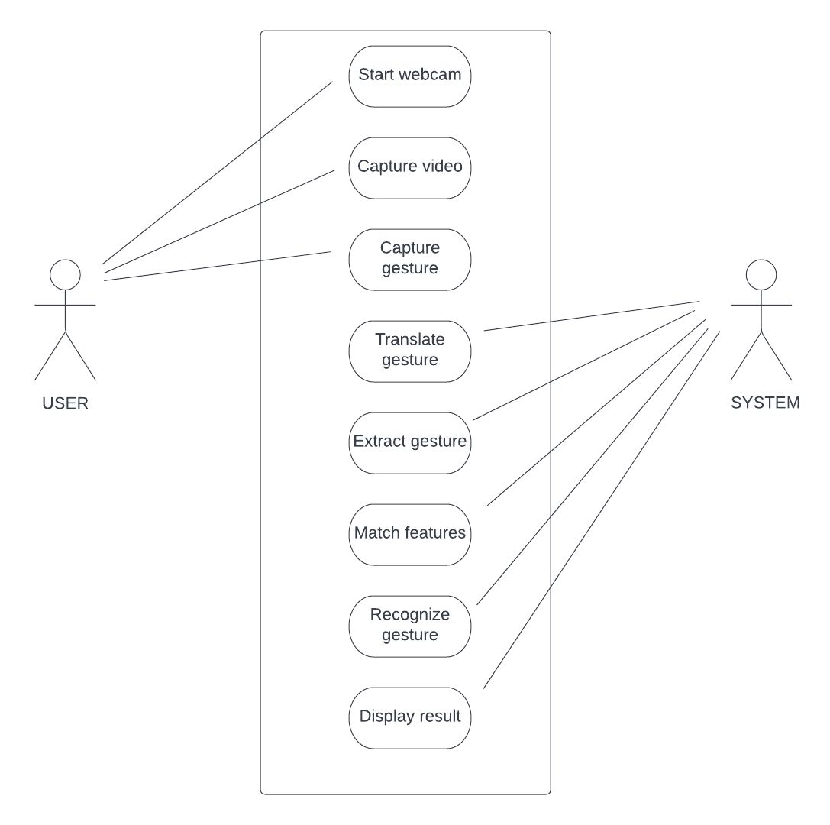
USE CASE

Slide 12
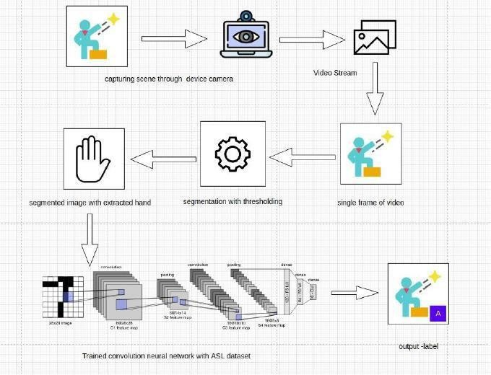
SYSTEM ARCHITECTURE

Slide 13
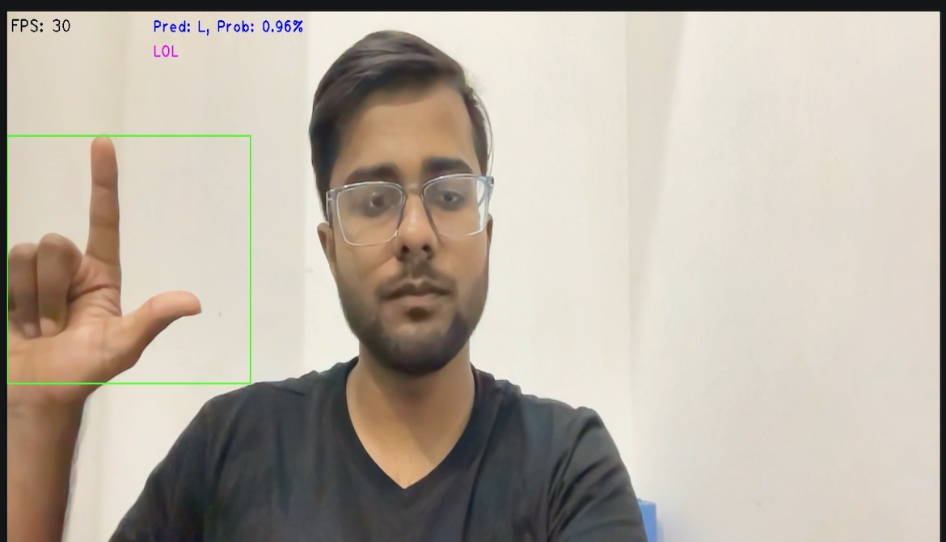
TESTING
Recognizing the word LOL

Slide 14
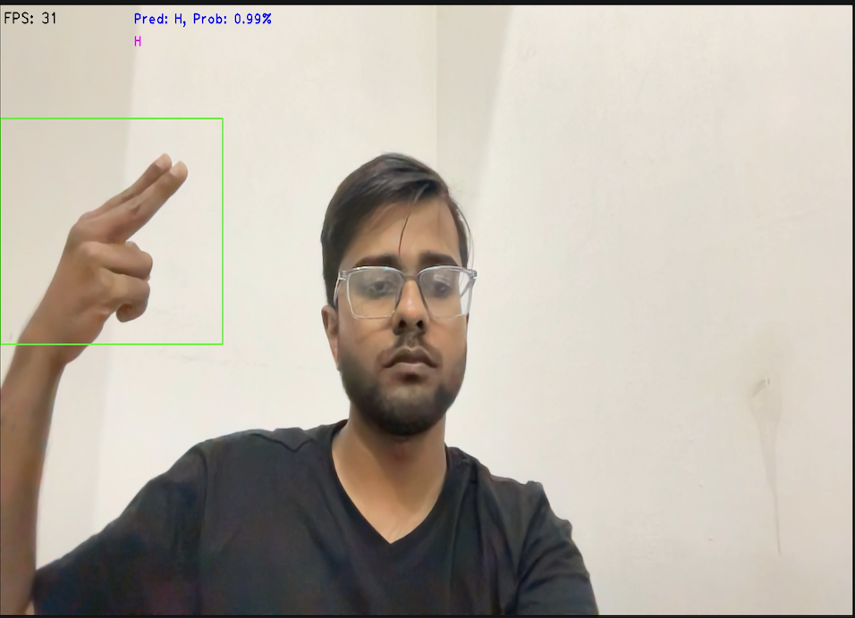
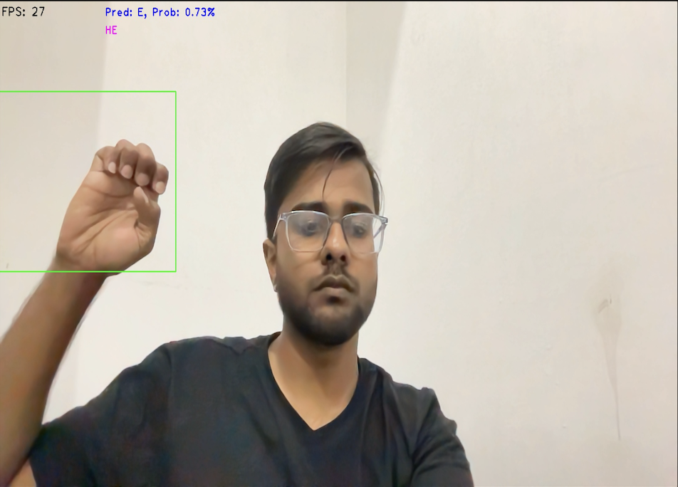
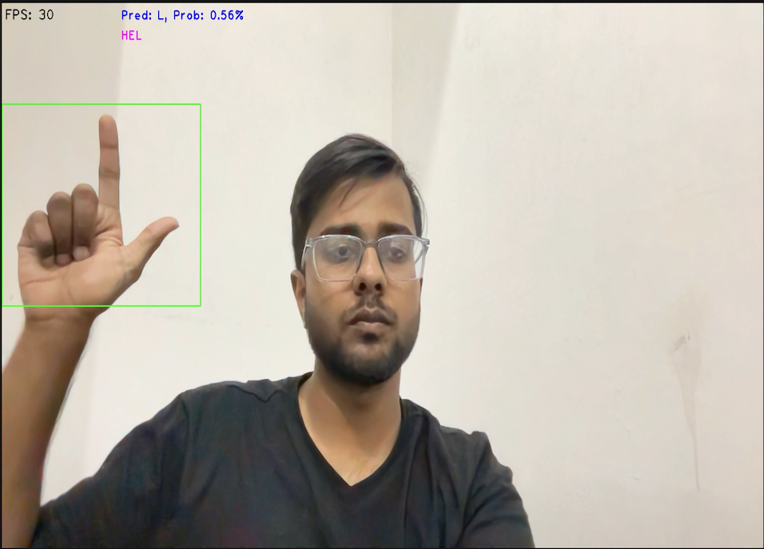
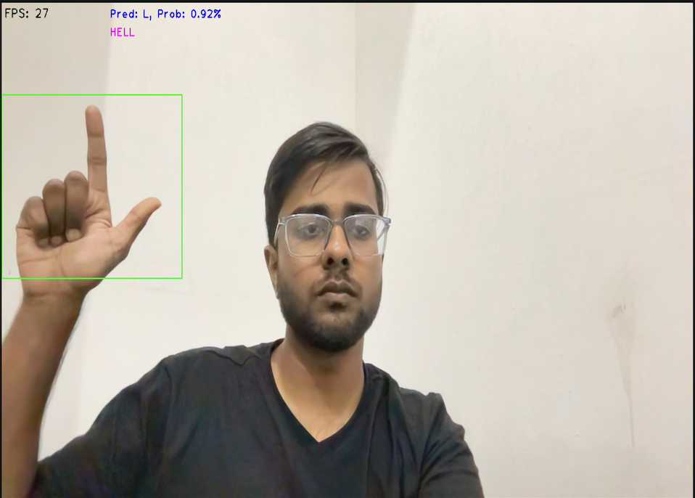
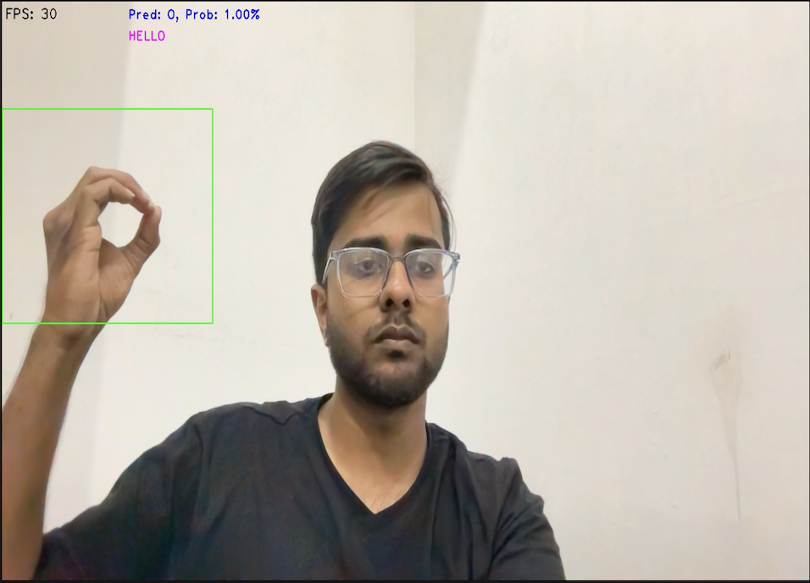
TESTING
H
E
L
L
O
Recognizing the word HELLO

Slide 15
CONCLUSION
Implemented an automatic sign language gesture recognition system in real-time using computer vision and machine learning techniques.
Trained the system on a dataset of 69,600 images, achieving a training accuracy of 99.99%.
Validated the system with a separate dataset of 17,400 images, obtaining an accuracy of 90.54%.
The system provides support to the deaf and mute community, allowing them to interact by performing sign language gestures.
The system automatically recognizes and translates the gestures into visible characters on the screen.
The project showcases the power of computer vision and machine learning in bridging communication gaps and empowering individuals with disabilities.
The real-time nature of the system ensures seamless and efficient communication.
The project demonstrates the successful integration of computer vision, machine learning, and web development for inclusivity and accessibility.

Slide 16
FUTURE SCOPE
Enhanced Gesture Recognition: Improve accuracy and robustness through advanced deep learning architectures, larger datasets, and transfer learning.
Multi-Language Support: Expand the system to recognize multiple sign languages for broader communication capabilities.
Real-time Translation: Integrate natural language processing techniques for real-time translation of sign language gestures.
Gesture Expansion: Recognize additional gestures beyond sign language, such as facial expressions or body movements.
Mobile Application Development: Develop a mobile application version for convenient and accessible sign language communication.
User Customization: Allow users to personalize the system with their own sign language gestures for improved recognition.
Collaboration and Integration: Collaborate with assistive technology organizations to integrate the system into existing devices and technologies.
Continuous Model Improvement: Implement mechanisms for continuous model improvement based on user feedback and real-world usage.

Slide 17
REFERENCES
Kaggle: www.kaggle.com - A platform for accessing datasets used in the project.
Python: www.python.org - The official website of the Python programming language.
TensorFlow: www.tensorflow.org - The official website of TensorFlow, an open-source machine learning framework.
OpenCV: opencv.org - The official website of OpenCV, a popular computer vision library.
Keras: keras.io - The official website of Keras, a high-level neural networks API.
Flask: flask.palletsprojects.com - The official website of Flask, a web framework used for backend development.
NumPy: numpy.org - The official website of NumPy, a fundamental package for scientific computing in Python.
HTML: developer.mozilla.org/en-US/docs/Web/HTML - Mozilla Developer Network (MDN) documentation for HTML.
CSS: developer.mozilla.org/en-US/docs/Web/CSS - MDN documentation for CSS.
JavaScript: developer.mozilla.org/en-US/docs/Web/JavaScript - MDN documentation for JavaScript.

Slide 18
THANK YOU

